Slide 1
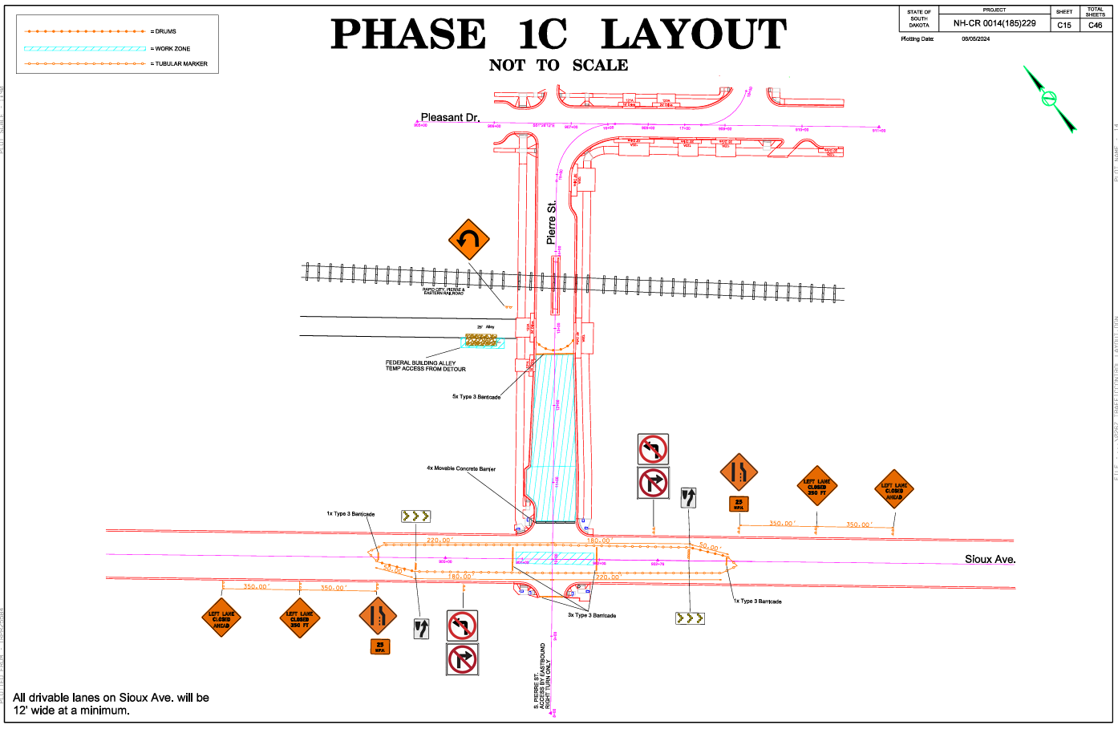
12’ Widith Restriction!

Slide 2
Street Parking
Handicap Parking

Slide 3
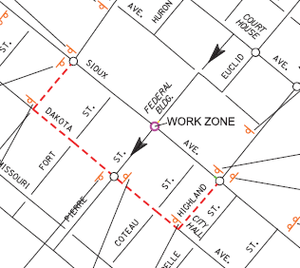
Detour to S. Pierre St.
Central
Highland

Slide 4
1C Phase Switch
Traffic Switch on Saturday June 28th
Pedestrian Traffic to remain as is
Federal Building access to remain as is
Vehicle access to Federal Building, Post Office, Corner Station to remain as is

Slide 5
June 28th
Gravel being installed front of Fed Building
Gravel and concrete going in between Capitol and Pleasant
Water and storm drain being installed between Capitol and Prospect
Monday June 30th, surfacing to be installed in center of Sioux Avenue

Slide 6

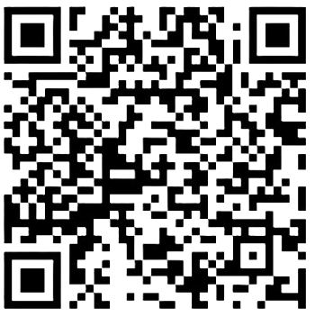
Project Website:
https://www.morris-inc.com/euclid-avenue-reconstruction-project/
Social Media:
https://www.facebook.com/morrisincpierre
https://www.instagram.com/morrisincsd/
Project Website:
Weekly Meeting:
Weekly Meetings to be held at AGC Building at 300 E Capitol Ave, Suite 1. Enter through side door on S. Highland Street.
Time: 11:00 AM
Day: Wednesdays

Slide 7
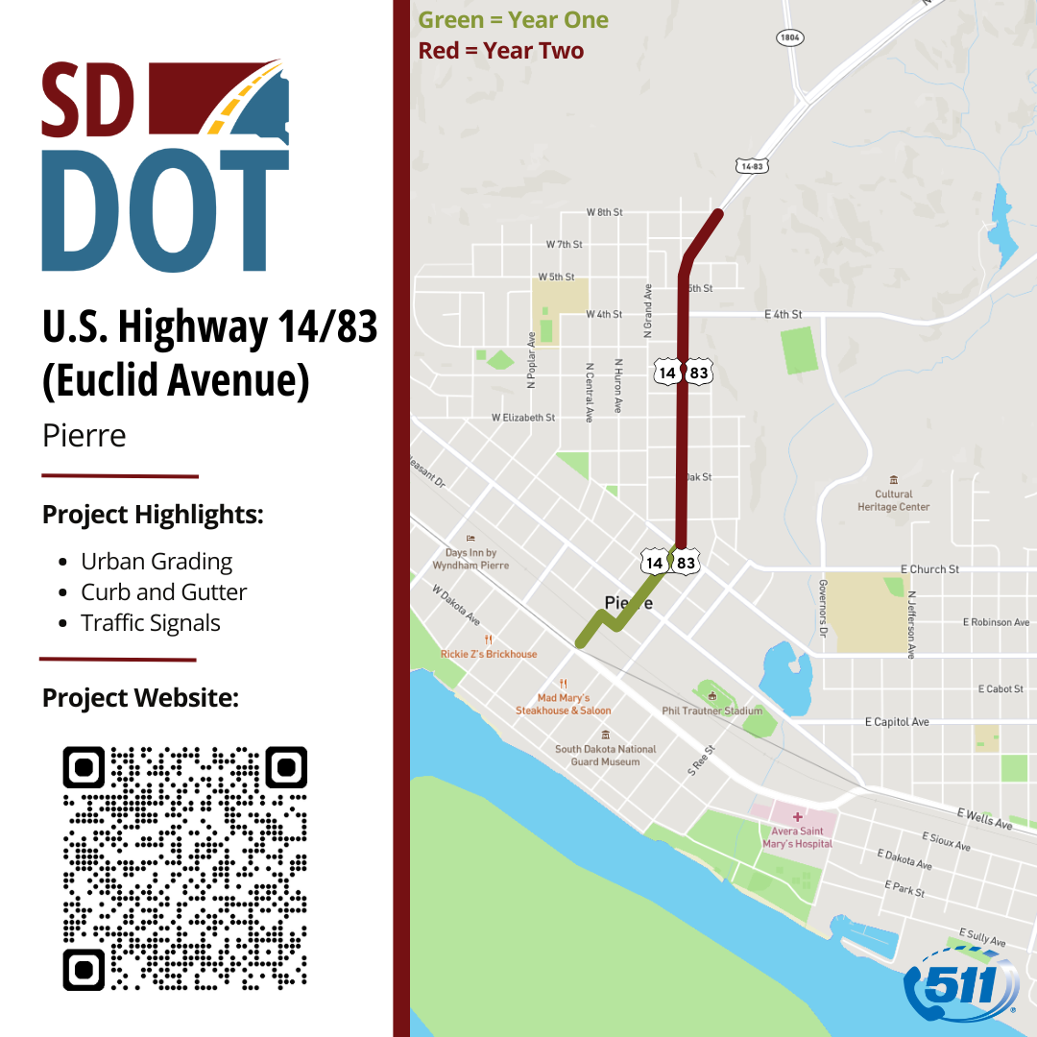
Project Website:
https://dot.sd.gov/euclid
Text Notifications:
For updates on major traffic changes during the project, subscribe to a free text-in service. To subscribe, text “EUCLID" to 605-566-4041. Subscribers can unsubscribe at any time.
SD511 Traveler Information:
For the latest on road and weather conditions, road closures, construction work zones, commercial vehicle restrictions, and traffic incidents, please visit https://sd511.org or dial 511.
Social Media:
https://www.facebook.com/southdakotadot
https://x.com/SouthDakotaDOT
https://www.instagram.com/southdakotadot
https://www.linkedin.com/company/southdakotadot

Slide 8


THANK YOU

